Slide 1
Applied Quantitative Analysis
BMGT438A/ENES489A

Slide 2


Instructors
Joe Bailey Jessica Strongin (Q36)

Slide 3
190
438a
390
490

Slide 4
190
Design Thinking
Quality/Voice of the Customer
Prototyping
Physical products, digital products, and process improvements
Iteration
Continuous Improvement
DMAIC
Garvin’s 8 Dimensions

Slide 5
438a
Framing the problem
Development of hypotheses
Identification, collection, ingestion, and analysis of data
Bais
Numbers and narrative

Slide 6
390
Disruptive technologies
Extrapolation
Culture and context
Thinking globally
Feedback loops
System Dynamics
Change management
Embracing complexity

Slide 7
490
Capstone QUEST Experience
Your toolkit is heavy but still incomplete
What tools will you use?

Slide 8
How can we listen to the ‘voice’ of the customer using data science?

Slide 9
Why 438a after 190?
You understand the importance of the voice of the customer but you may not know how that voice translates into data
You have designed innovative products and processes but you need to know how to continually improve these things using data
DMAIC is a data-driven concept

Slide 10
Why learn data science?
It is important to know
It spans the QUEST disciplines of business, engineering, and science
It will help you in your future QUEST classes
390 – building models using python
390 – designing systems where data is an important feedback mechanism
490 – all of the capstone projects have elements of data science
It will be important to your career

Slide 11
Data Science

Slide 12
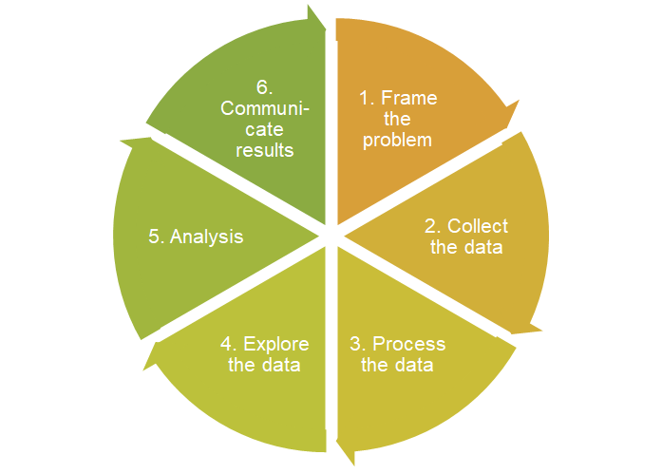
Frame the Problem
Collect Raw Data
Process the Data
Explore the Data
Analyze the Data
Communicate the Insights

Slide 13
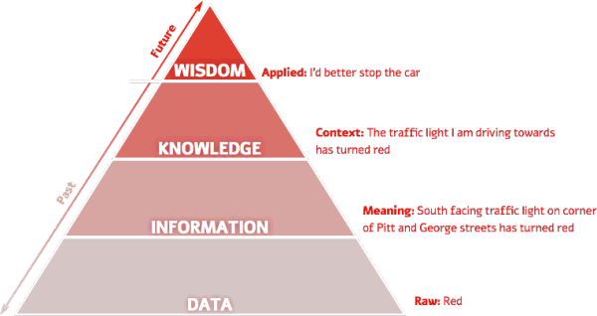

Slide 14
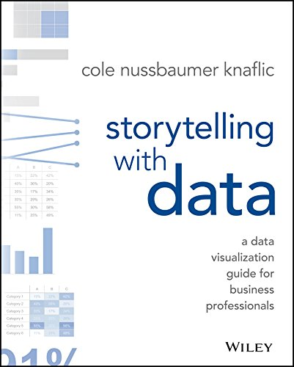

Slide 15
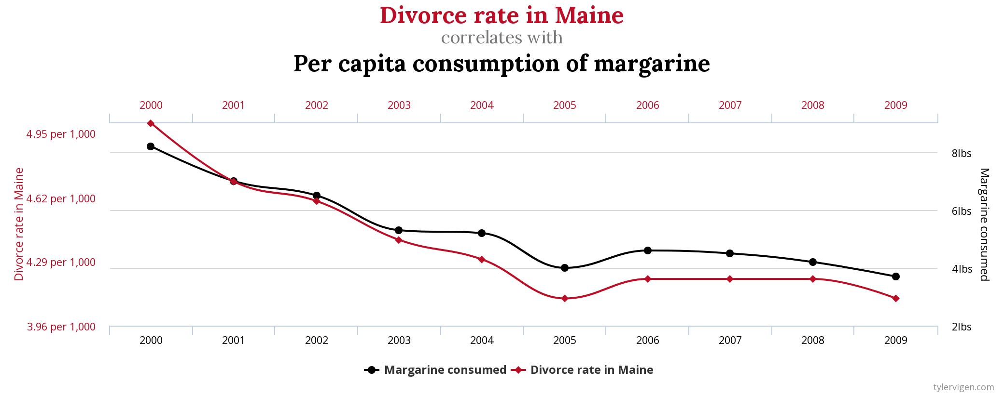
Spurious correlations
Notes:
https://www.tylervigen.com/spurious-correlations

Slide 16
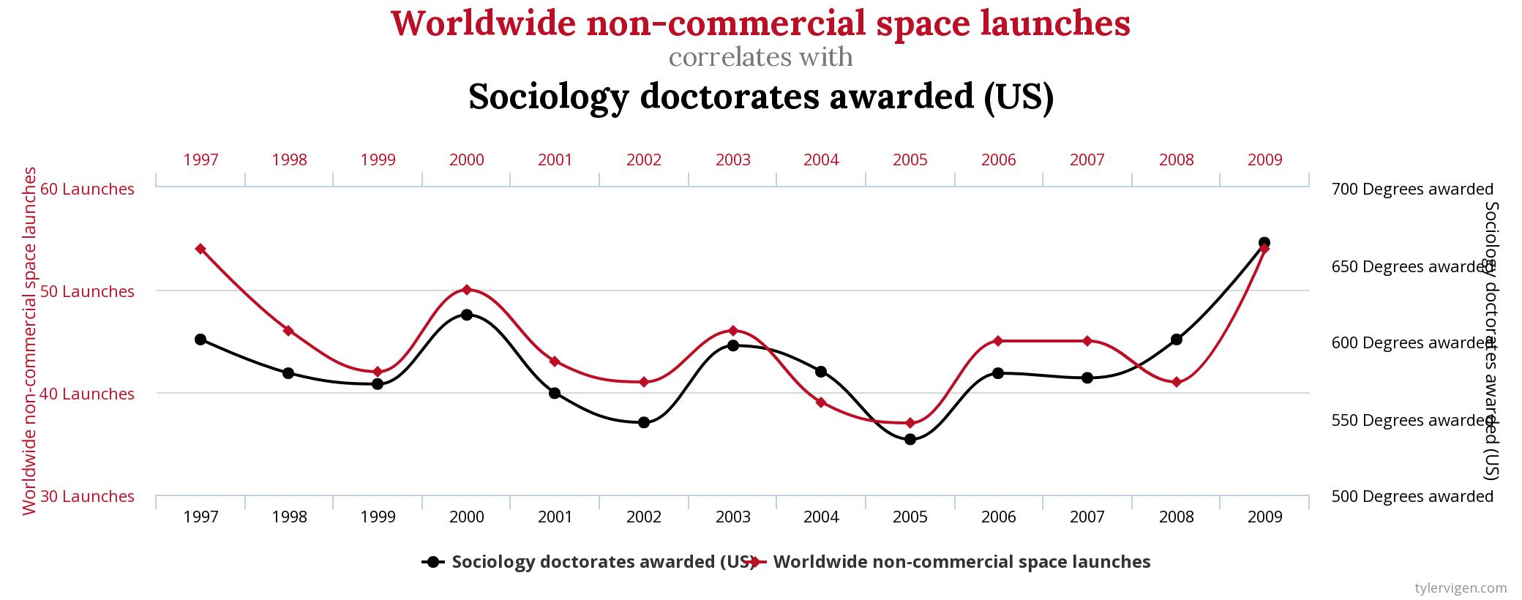
Spurious correlations
Notes:
https://docs.google.com/document/d/1p7394VhpqP5V6QYiXdhGDBmnjb2VFvmndegKypNy06w/edit?usp=sharing

Slide 17
2. Framing the Opportunity

Slide 18
Develop good client communication norms
Introduce yourselves in an email
Set expectations
Communication norms (email/phone/text?)
Email response time (one business day)
Don’t let them push around (stay in scope)
Have weekly meetings (around 30 minutes)
Set an agenda (facilitator)
Take notes (notetaker)
Send a recap
Ask lots of questions
Communicate intermediate and draft deliverables

Slide 19


Slide 20
Questions to Consider
What variables do you have?
independent variables vs. dependent variables
What is your unit of analysis
Individual, group, company, market, country
Is your data collected at the same time
Cross-sectional vs. time series
How many observations do you have?
10 vs. 100 vs. 1,000 vs. 10k vs. 100k +
What unobserved heterogeneity do you have?

Slide 21
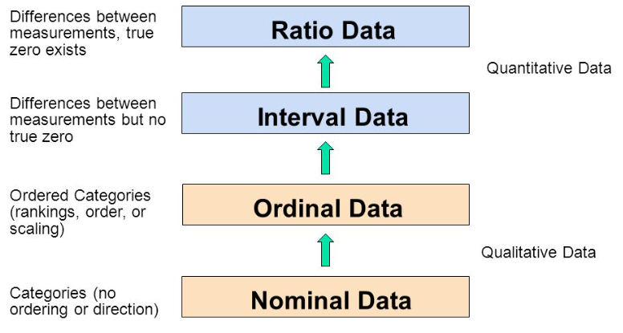

Slide 22
3. Data Quality

Slide 23
Prompt: If Chipotle wanted to see how well each store performed, what data would it collect?

Slide 24
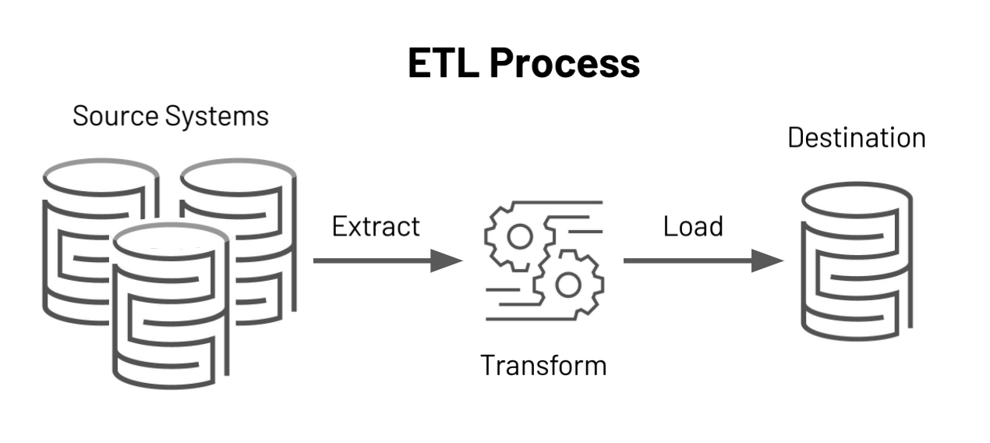
ETL: Extract, Transform, and Load

Slide 25
Data Exploration Steps
Univariable study - understand each of the key variables
Multivariate study - look for relationships in the data
Test assumptions - does our data meet the assumptions of multivariate methods?

Slide 26
Useful starting points for cleaning the data
Confirm data type and number of non-null in each column: use info()
Look for invalid values (numerical data) - use describe()
Remove duplicate elements: unique()
Check validity of values in columns (ex. number of students in a class must be >=0)
Visually inspect snapshot of values with df.head()
Notes:
Describe will highlight min, max value issues

Slide 27
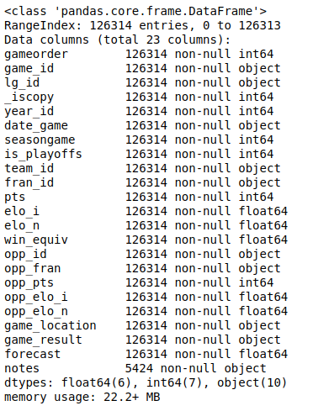
.info() example
nba.info()

Slide 28
Univariate Study: Descriptive Statistics
describe() calculates descriptive statistics
size() returns the number of elements
mean() returns the sample mean
median() returns the sample median
range() returns the largest and smallest values
quantile() calculates percentiles
count(), min(), max(), std()

Slide 29
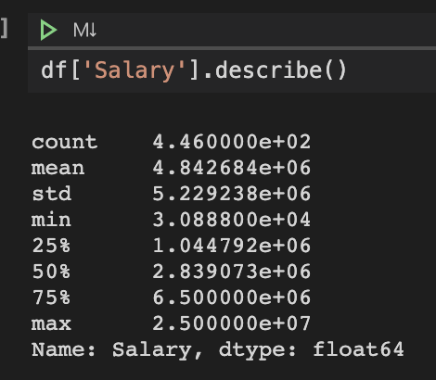
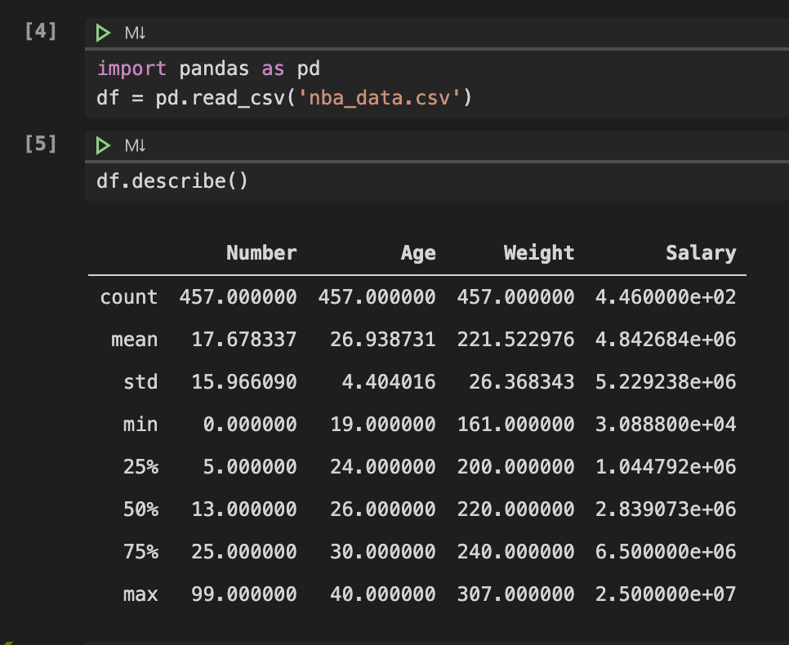
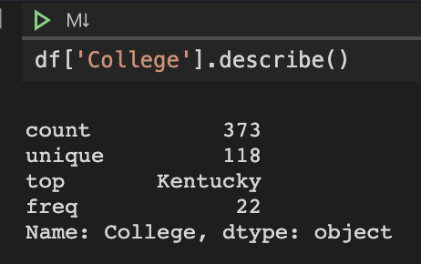
Descriptive Statistics
Using describe() on the dataframe (applied to all numeric variables) and on individual columns, both numerical and categorical.

Slide 30
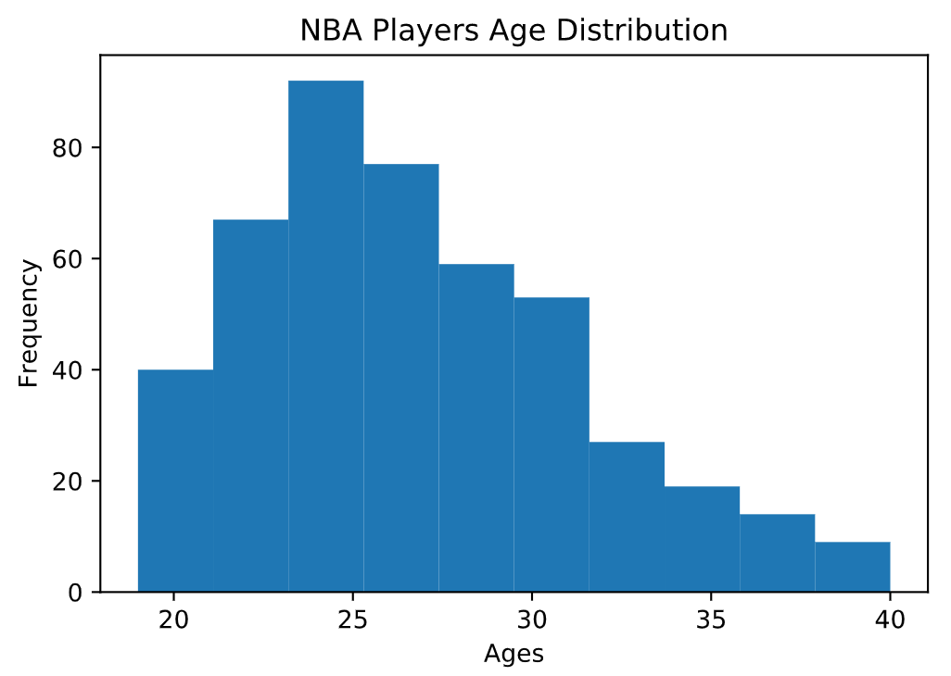
Univariate Study:
Frequency distributions
Create a dataframe for numerical variables
df_num=df.select_dtypes(include=[‘float64’,‘int64’])
Explore df.plot.hist(), df.plot.bar()
Can name axes with
df.set(xlabel=”...”, ylabel=”...”, title=”...”)

Slide 31
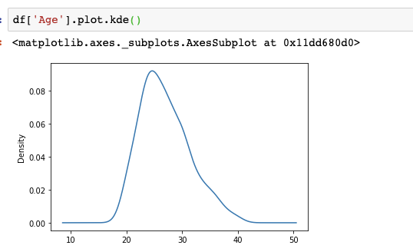
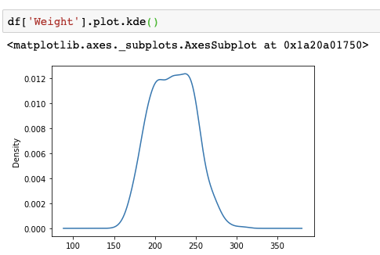
Univariate Study: Kernel Density Estimation
Creates a continuous curve based on histogram of data
Can be used to estimate the probability density function
Notes:
Useful for determining the type of distribution a variable seems to have; is it normal or not? What might explain skewness, location of peaks?
generating points that come for this distribution.

Slide 32
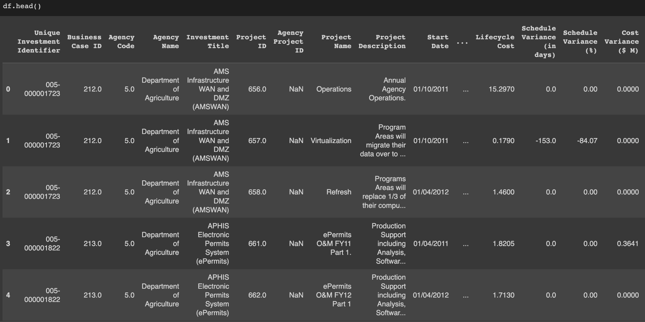
Univariate Study: Note the Type of Data
Cross Sectional Data
Descriptive statistics, frequency distribution, kernel density
Categorical and numerical variables
Notes:
Cross-sectional data are observations that come from different individuals or groups at a single point in time.

Slide 33
Schema (how the data is constructed)
INT
FLOAT
DATE (what time zone is it in?)
STRING
BOOLEAN

Slide 34
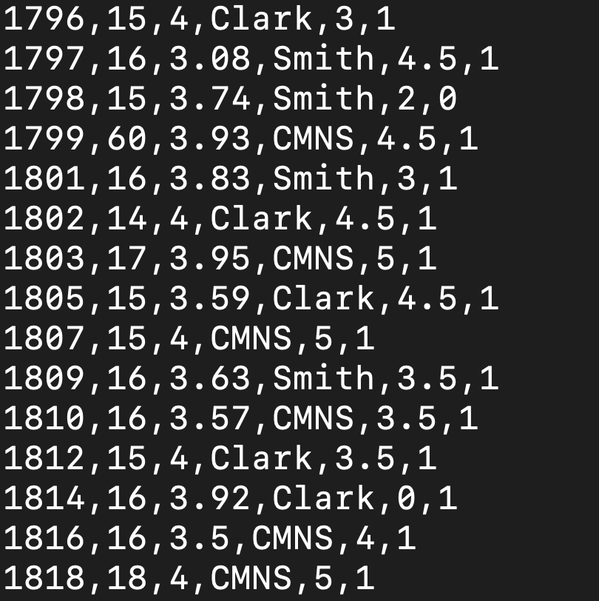

Slide 35
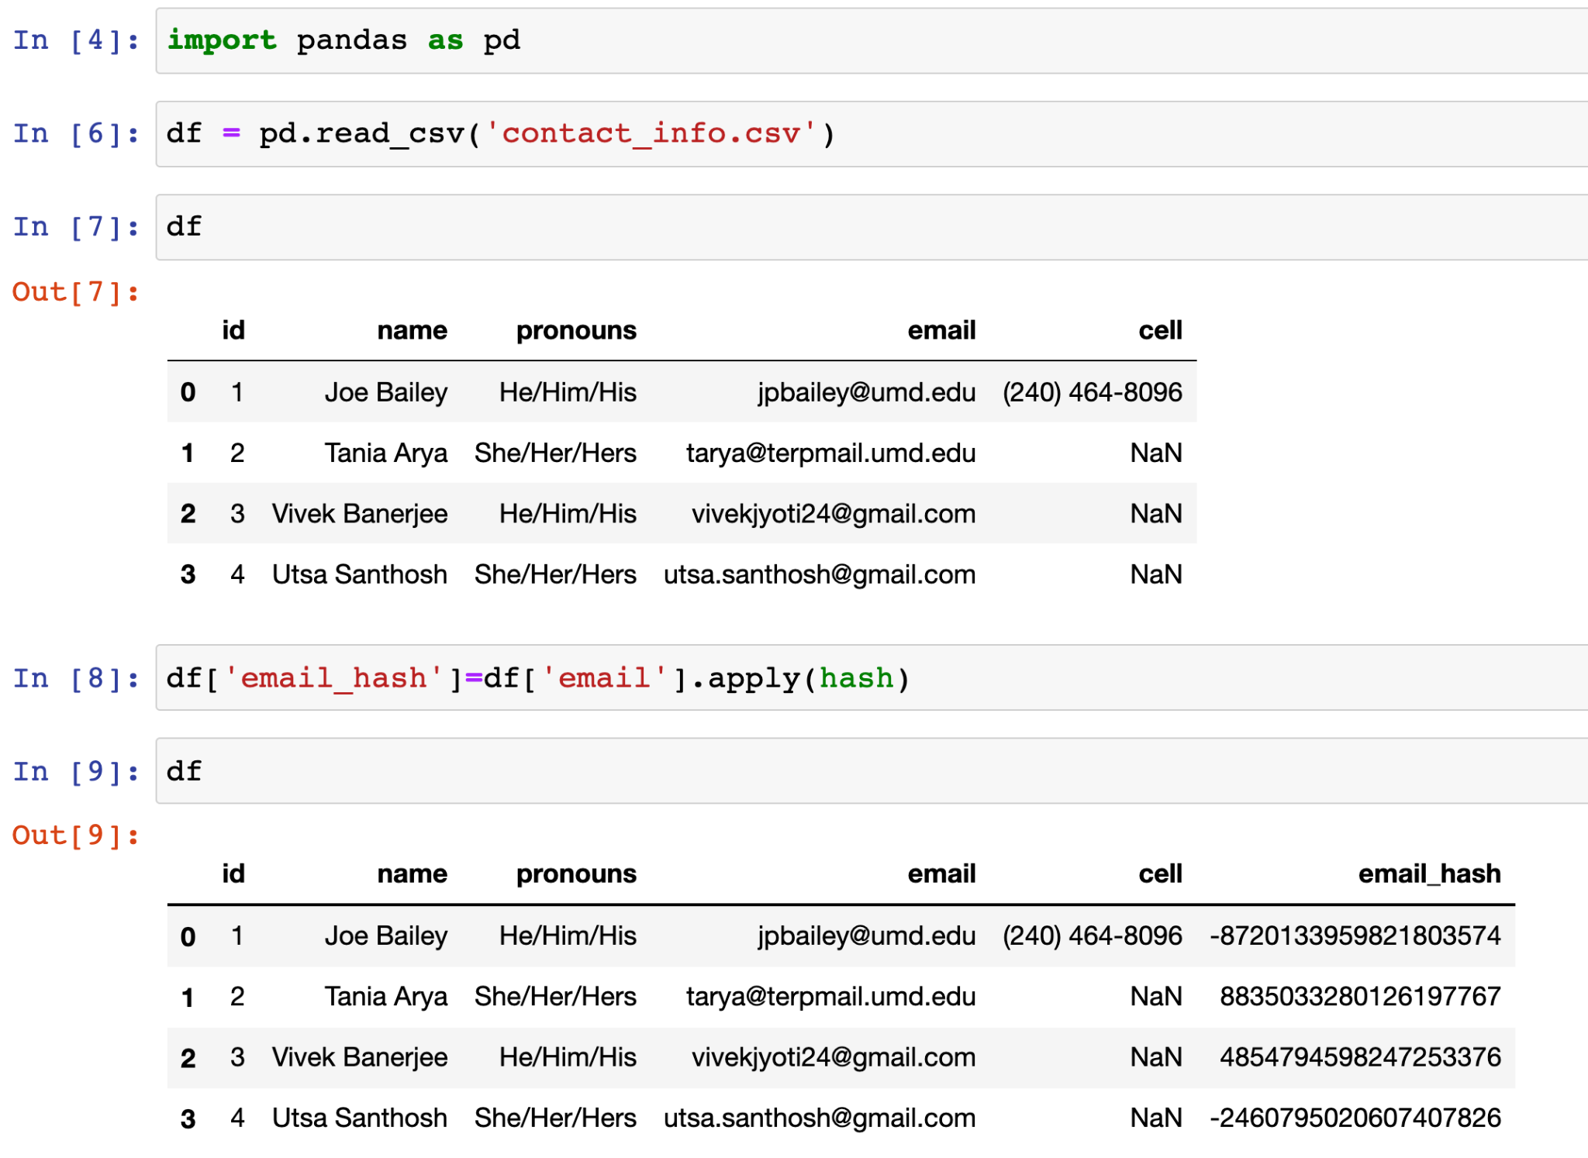

Slide 36
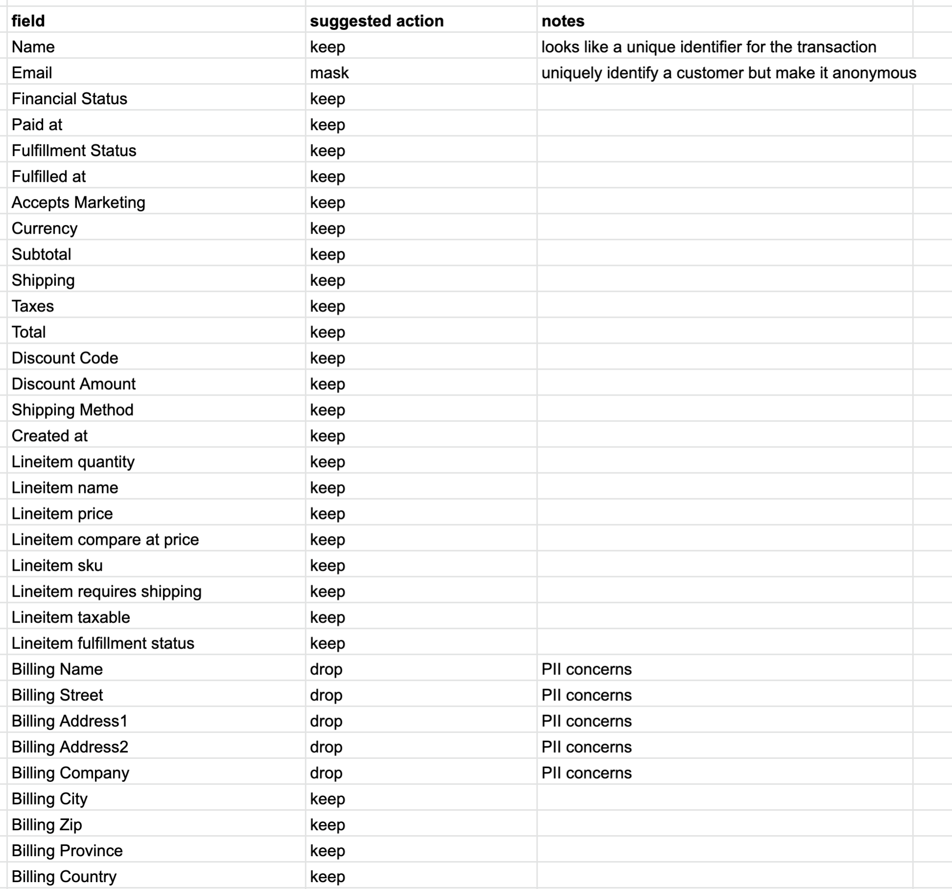

Slide 37
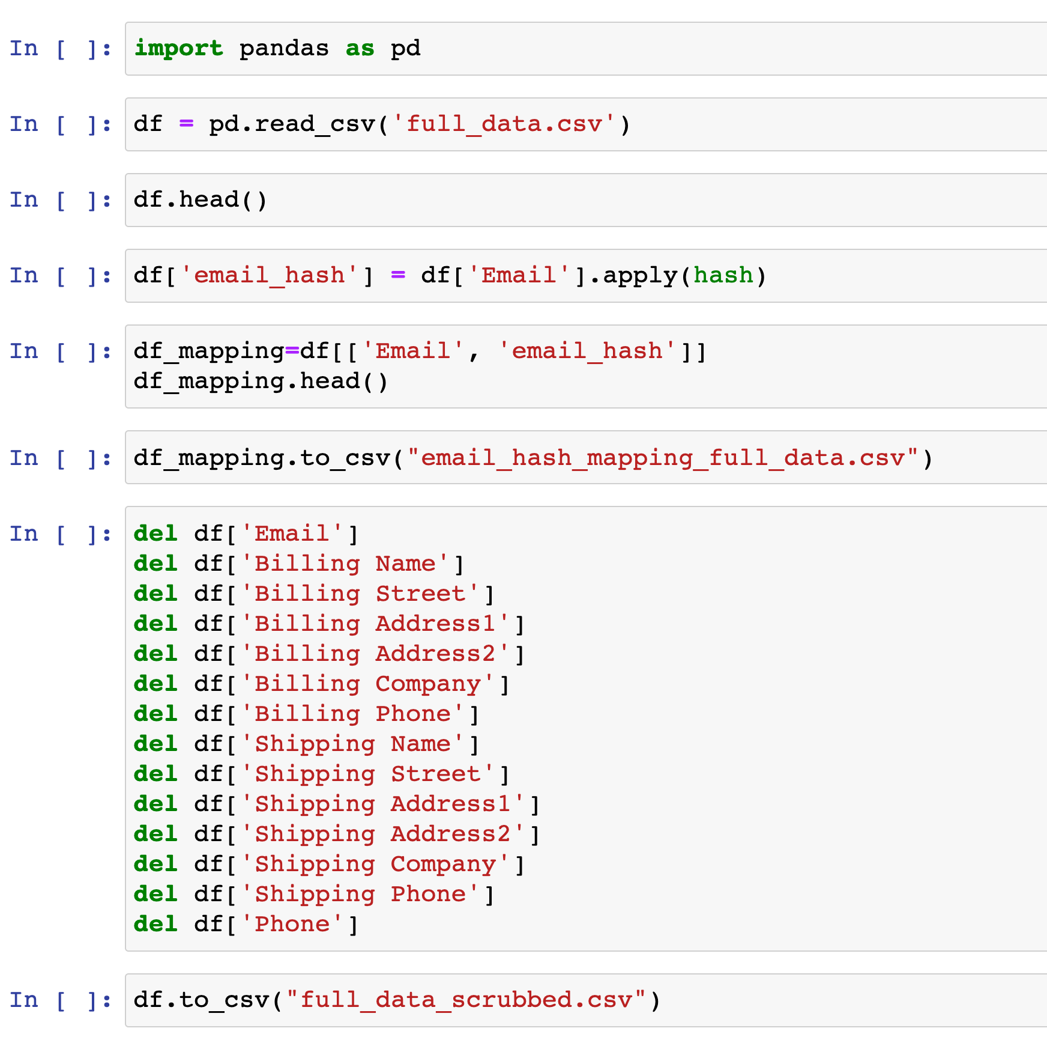

Slide 38
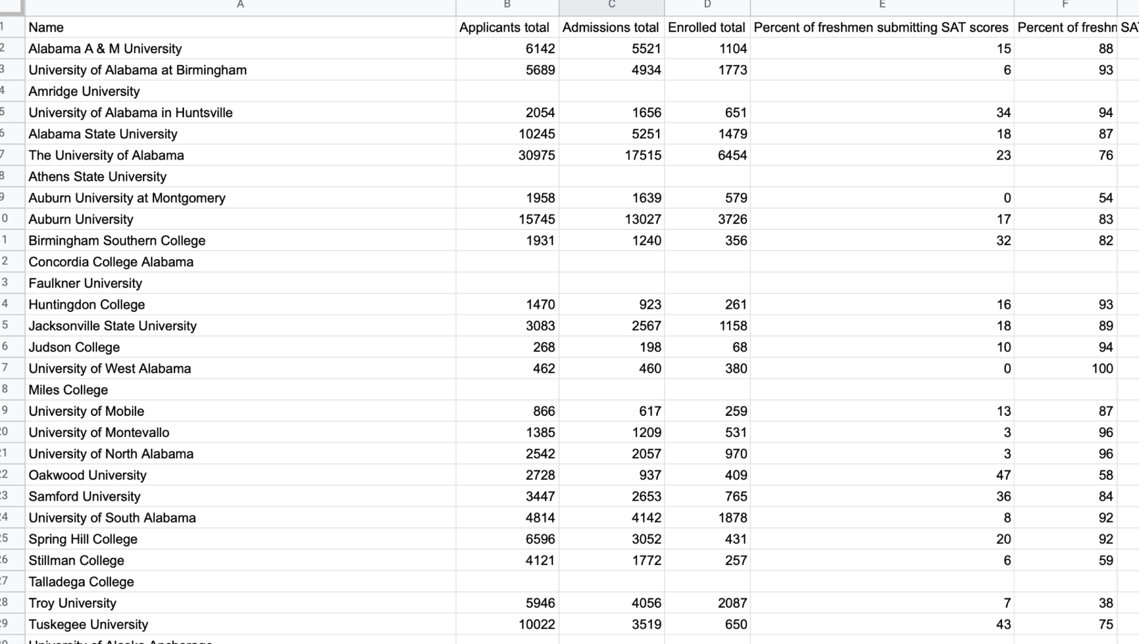
What's wrong here?

Slide 39
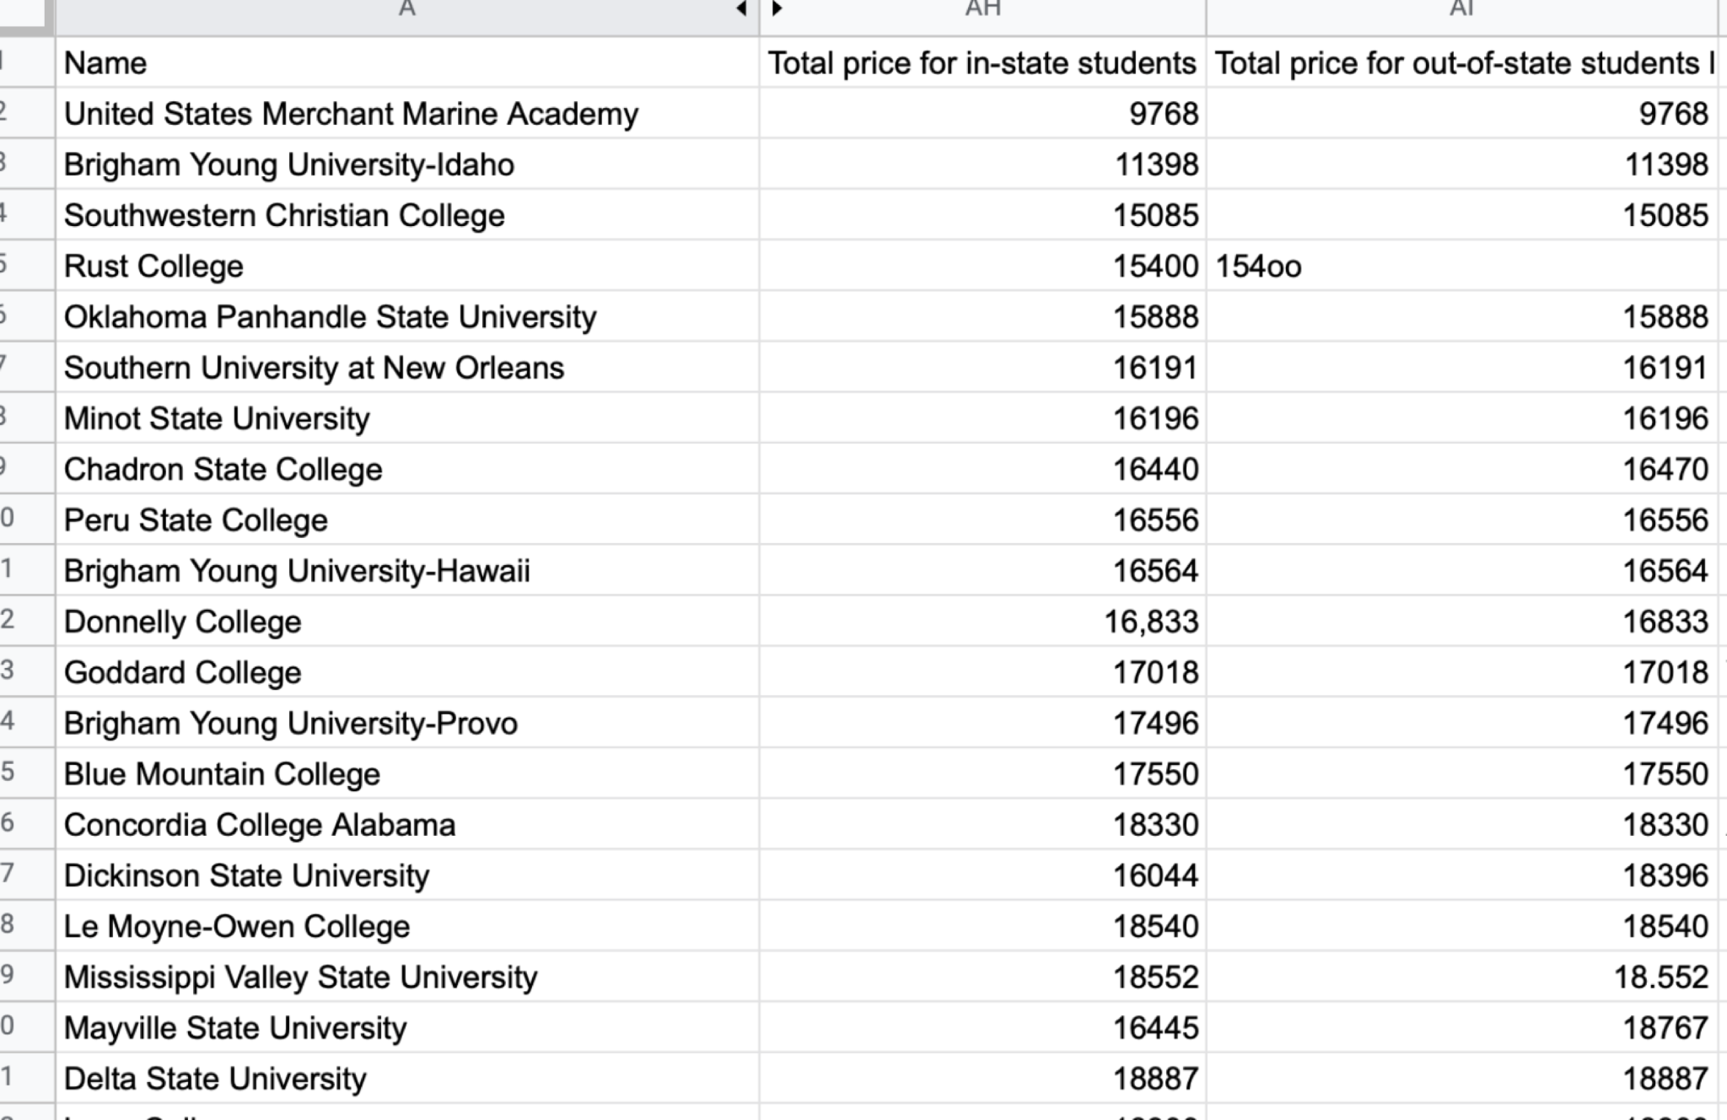
What's wrong here?

Slide 40
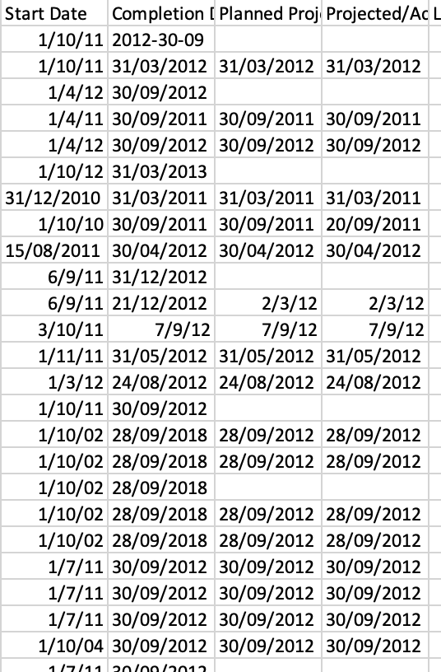
Date?

Slide 41
Data Quality Issues
Date validation
Number format
Text ⇔ numbers
Missing data
Duplicate data
Redundant data
Combined data and separated data

Slide 42
Date validation
What month and day is the date: 30/01/2019?
How about the year 04/05/2019?
How about 2019-04-05?
Example:
df[‘date’] = pd.to_datetime(df['string_date'])

Slide 43
Number format
If the price for one item is 5.00 and another is 4.95, are they the same price?
What happens if you round the price for each item to 5?
What happens if the price is reported as an integer once (5) and a decimal another place (4.95) for the same item?
Example:
round(4.95, 0) => 5.0
int(4.95) => 4
int(round(4.95,0)) => 5

Slide 44
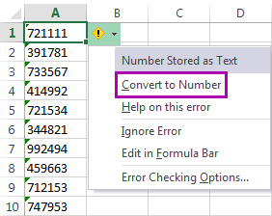
Text ⇔ numbers
id="123456789"
print(type(id)) => str
id_num = int(id)
print(type(id_num)) => int

Slide 45
Common Causes of Outliers
Data entry errors (human errors)
Measurement errors (instrument errors)
Data processing errors (data manipulation or data set unintended mutations)
Sampling errors (extracting or mixing data from wrong or various sources)
Natural (not an error, novelties in data)
Notes:
Outliers can contain valuable information - it is hard to know what the true cause actually is - is it truly an error, or is it telling us something important? (example)
The best method of handling outliers depends on the objective of your
analysis, on how you obtained your data…

Slide 46
When to drop outliers
When it is obvious that it is due to incorrectly entered or measured data (e.g., age is 231)
Otherwise, keep outliers for now, but make note of them; we will need to address them in our analysis.
Outliers often affect both results and assumptions of analysis.
Notes:
Query data to understand outliers
May need to do some preliminary investigation of whether it is normal data or an error - what does the rest of the data in the row look like?

Slide 47
4. Data Transformations

Slide 48
You are analyzing donor data and you see the following two donations were made in 2019:
Is this the same person?
Name | Email | Address | Amount | Date
John Smith | jksmith@startup.com | 124 Main St.; College Park, MD | $1,000 | 1/15/2019
John K. Smith | jksmith01@umd.edu | 124 Main St.; College Park, MD | $100 | 6/1/2019

Slide 49
Types of transformations
Expanding and collapsing rows and columns
Mathematical transformations
Transforming words
Transforming images

Slide 50
Collapsing and Expanding Columns
Collapsing
Combine two pieces of data into one
Example:
Df[‘name’] = df[‘first_name’] + “ “ + df[‘last_name’]
Expanding
Parse an observation based on a delimiter
Example:
df[‘name’] = “John Smith” into df[‘first_name’] = “John and df[‘last_name’] = “Smith”

Slide 51
Collapsing rows
Order | Customer | Amount
1 | A | $20
2 | A | $20
3 | B | $5
4 | A | $15
5 | B | $55
Customer | Amount | Orders
A | $55 | 3
B | $60 | 2

Slide 52
Expanding rows
Customer | Month | Spending
A | 1 | $20
B | 1 | $0
A | 2 | $20
B | 2 | $5
A | 3 | $15
B | 3 | $55
Order | Customer | Amount | Date
1 | A | $20 | 1/15/22
2 | A | $20 | 2/20/22
3 | B | $5 | 2/25/22
4 | A | $15 | 3/30/22
5 | B | $55 | 3/30/22

Slide 53
Questions to ask when collapsing and expanding
What is the unit of analysis?
Should I transform the data to work with a different unit of analysis?
When an observation is missing, does it tell me something?
Are there variables that work better together or separate?

Slide 54
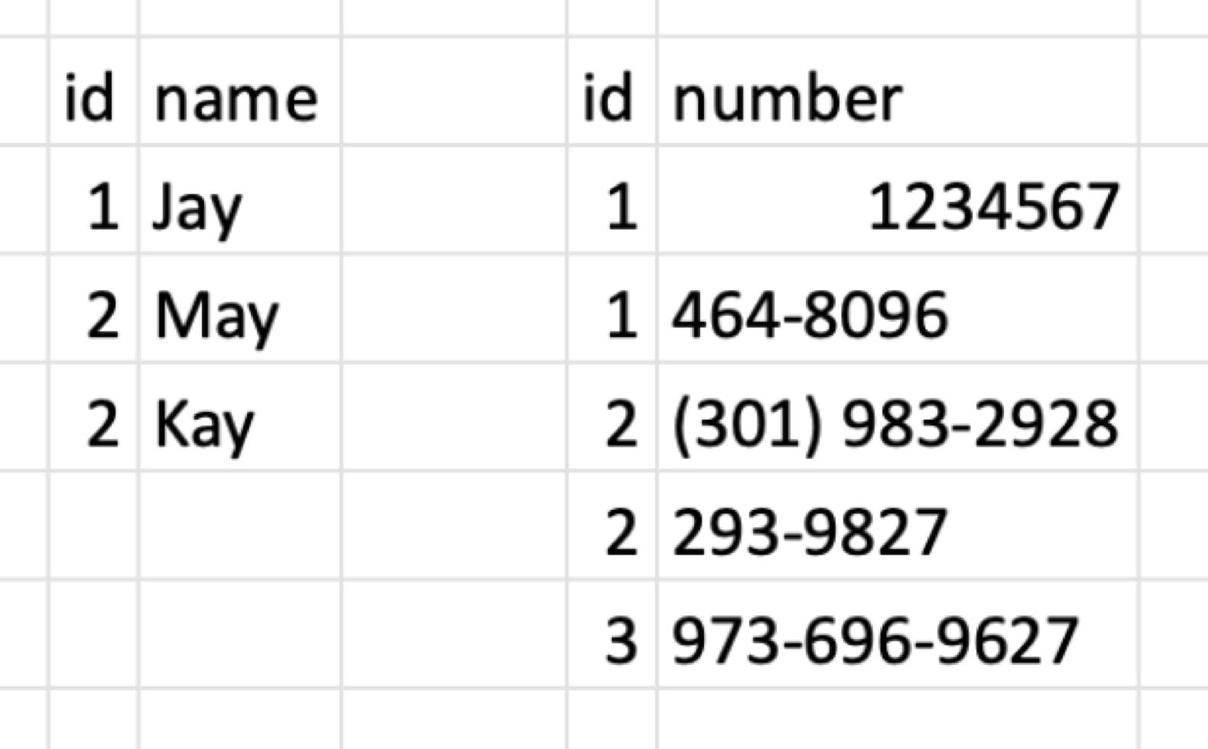
What's wrong here?

Slide 55
Missing data
If we have a database with gender information and some are marked as ‘f’ and some are marked as ‘m’, what can we infer when the data is missing?
If we are looking at temperature over time and have observations every 5 minutes, but one of the observations is missing, what do we do?
2pm | 2:05pm | 2:10pm | 2:15pm | 2:20pm
65 | 65 |  | 65 | 64

Slide 56
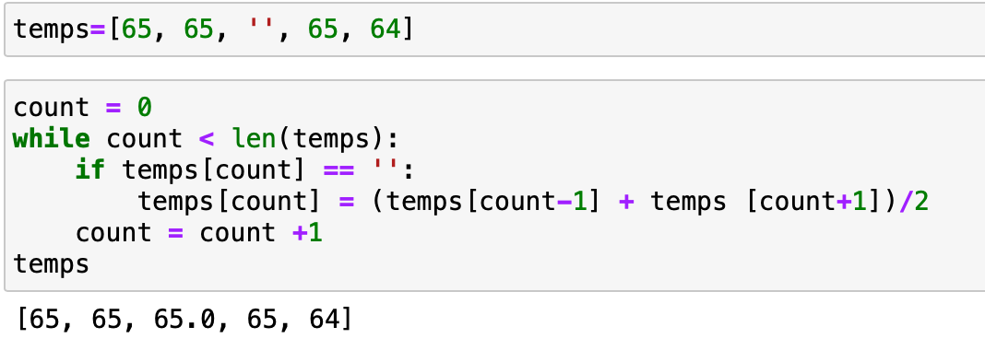

Slide 57
Duplicate data
What happens if we have two people with the same name in our database? Does it matter if the name is “John Smith” vs. “Fifer Testudo”?
If two people on the same QUEST team submit the team deliverable, which one should we accept?
Submission 1 | Submission 2
10/1/2020 | 10/1/2020
11:05pm | 11:30pm
15 pages | 10 pages
pdf | docx

Slide 58
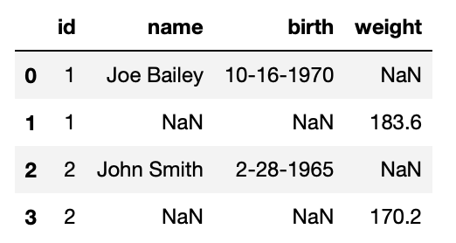
Redundant data
If we have birth date and age in a database, do we need to keep both?
If no, which one do we keep?

Slide 59
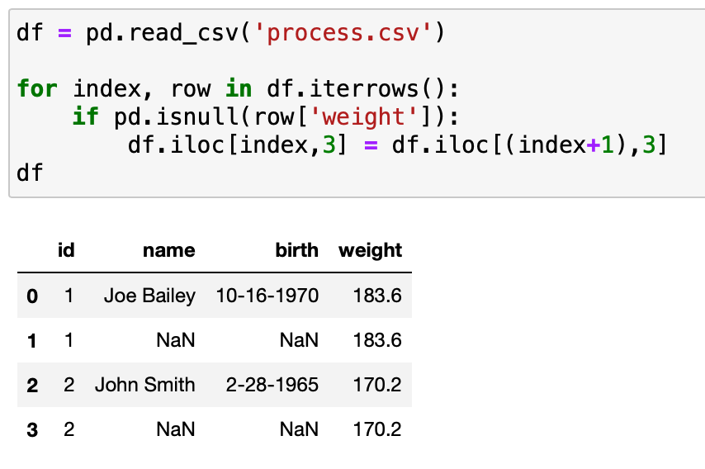

Slide 60
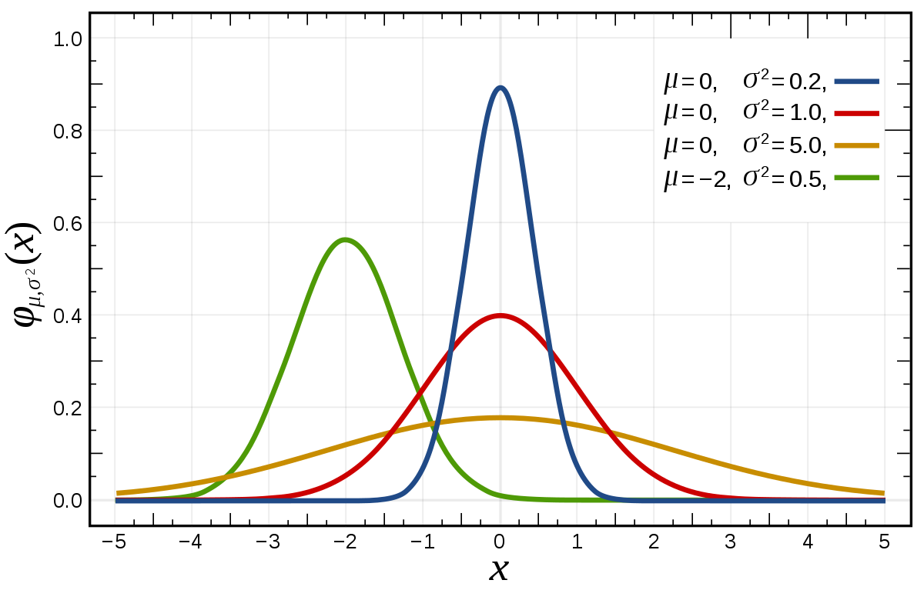
Normality of Observation

Slide 61
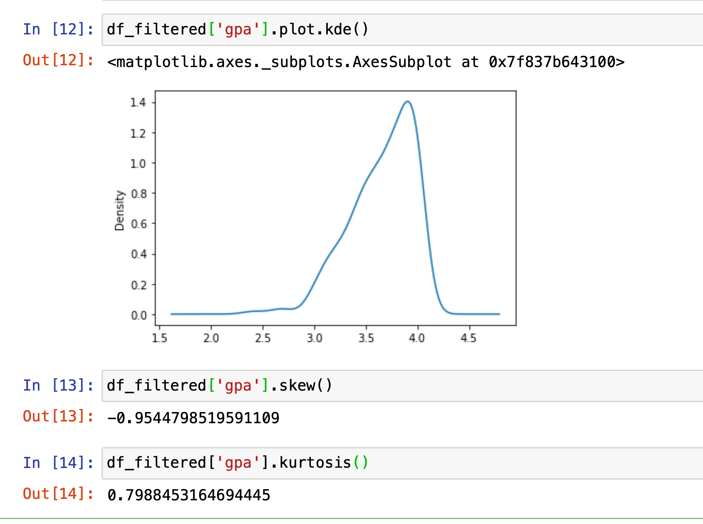
rule of thumb -0.8 to 0.8 for skewness and -3.0 to 3.0 for kurtosis.

Slide 62
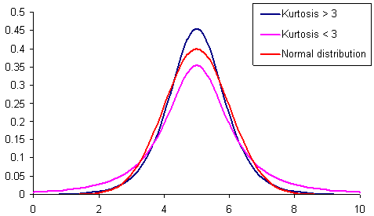
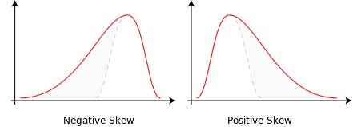
Skewness, Kurtosis
Left skewed
Right skewed

Slide 63
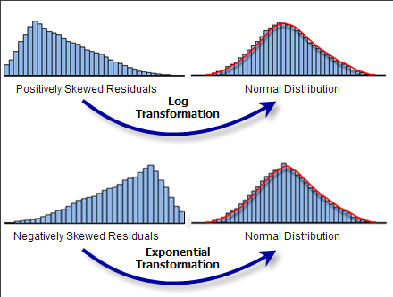
Log and Exponential Transformations

Slide 64
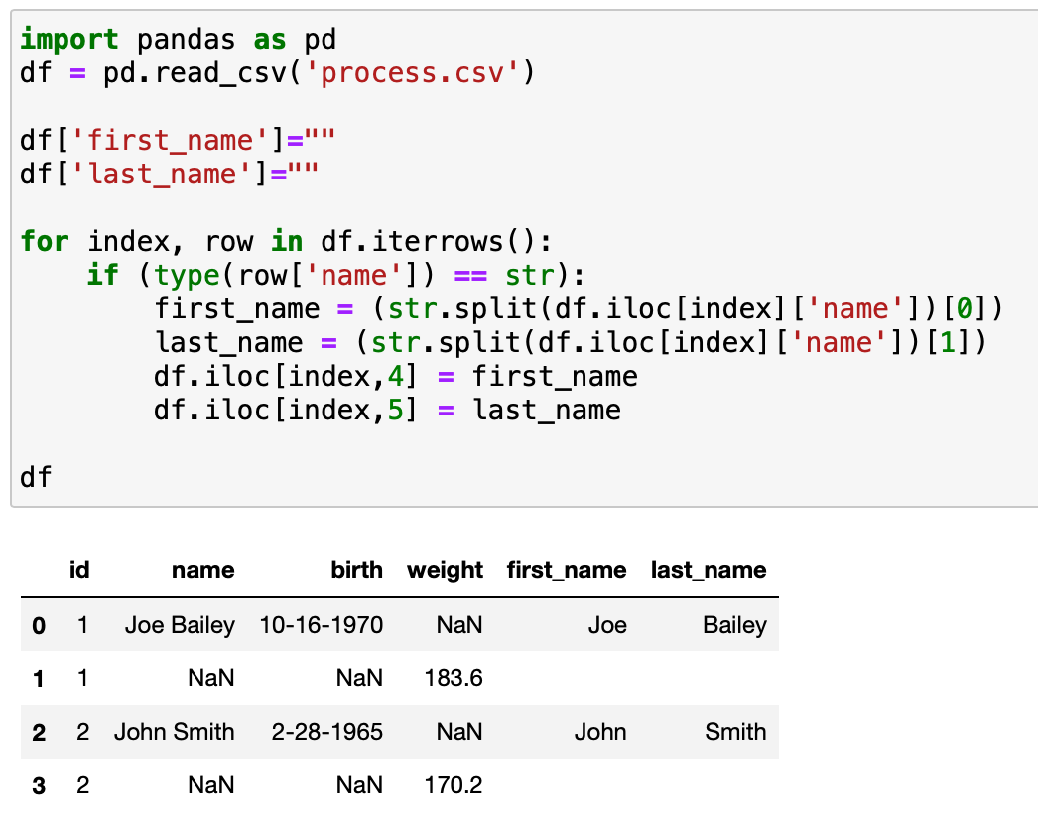

Slide 65
Image transformations
Patterns for matching
Handwriting recognition
Optical Character Recognition

Slide 66
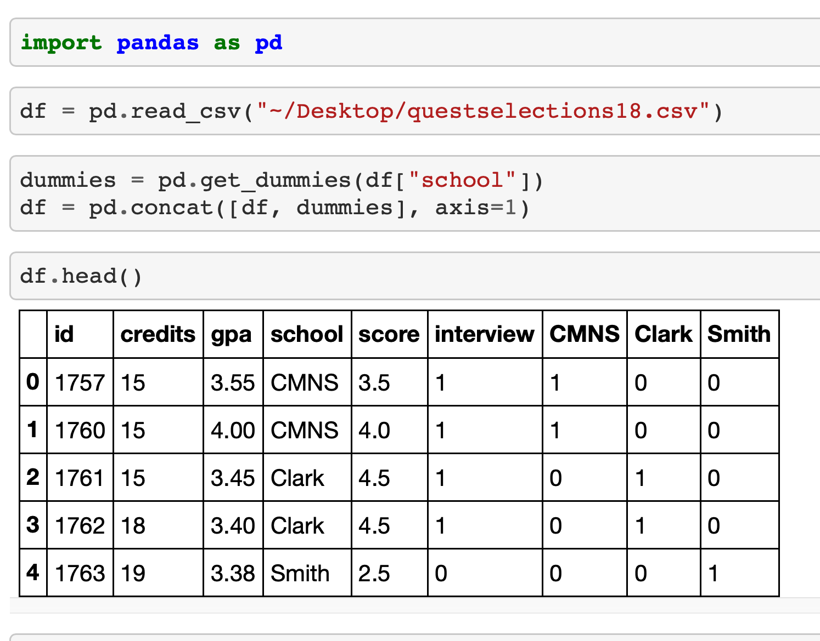

Slide 67
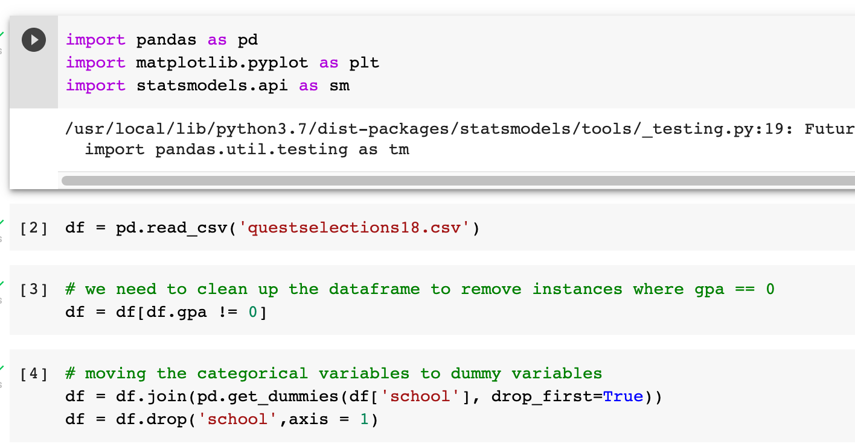

Slide 68
Dummy Variables
Make sure to use dummy variables for categorical variables
Number of dummies = # of groups -1
E.g. if year = {freshman, sophomore, junior, and senior}, then you need three dummy variables
Often used in control variables
E.g. controlling for gender

Slide 69
Dummy Variables
Make sure to use dummy variables for categorical variables
Number of dummies = # of groups -1
E.g. if year = {freshman, sophomore, junior, and senior}, then you need three dummy variables
Often used in control variables
E.g. controlling for gender

Slide 71
Natural Language Processing
How can a new product development team use Amazon reviews to design new products?

Slide 72
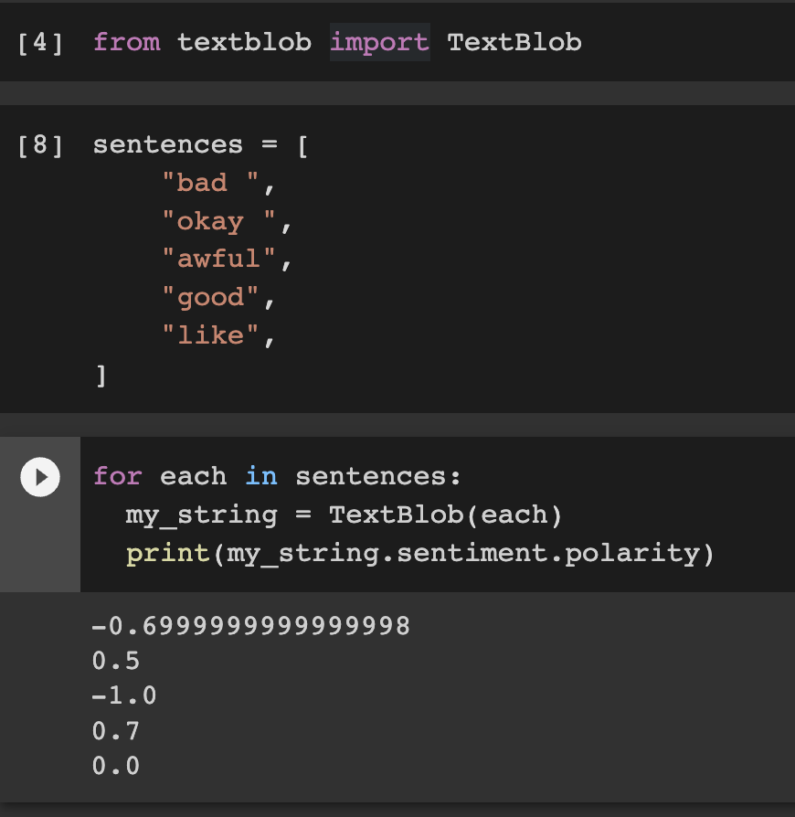

Slide 73
General Techniques of NLP
Remove stopwords
Create stems of words (i.e. remove prefix and suffix)
Lemmatize the words (i.e. move synonyms to the same root)
Consider tuples of words
Transform words into numbers (dummy encoding, gensim, …)

Slide 74
5. Team Presentations

Slide 75
Team Presentation Content
Who is your client?
How does your client use data?
What questions does your client want to answer?
What type of data will your client share with you?
Have you encountered any data quality issues?
Can you share with us any descriptive statistics?
How does the qualitative data mesh with the quantitative data?

Slide 76
6. Data Exploration

Slide 77
Visit from Tuscany Consulting
How can you consider several variables at once in creating a ranking
Warm-up: How can you look at the markets to sell snow shovels?
Weather
Demand
Competition
…
Exercise: Where should a nursing school expand to a new location?
Need
Supply
Demographics
…

Slide 78
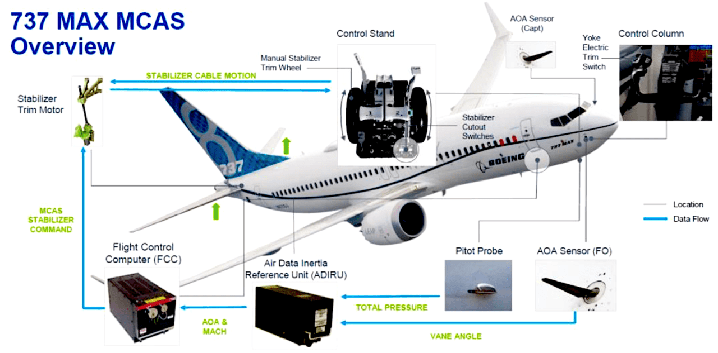

Slide 79
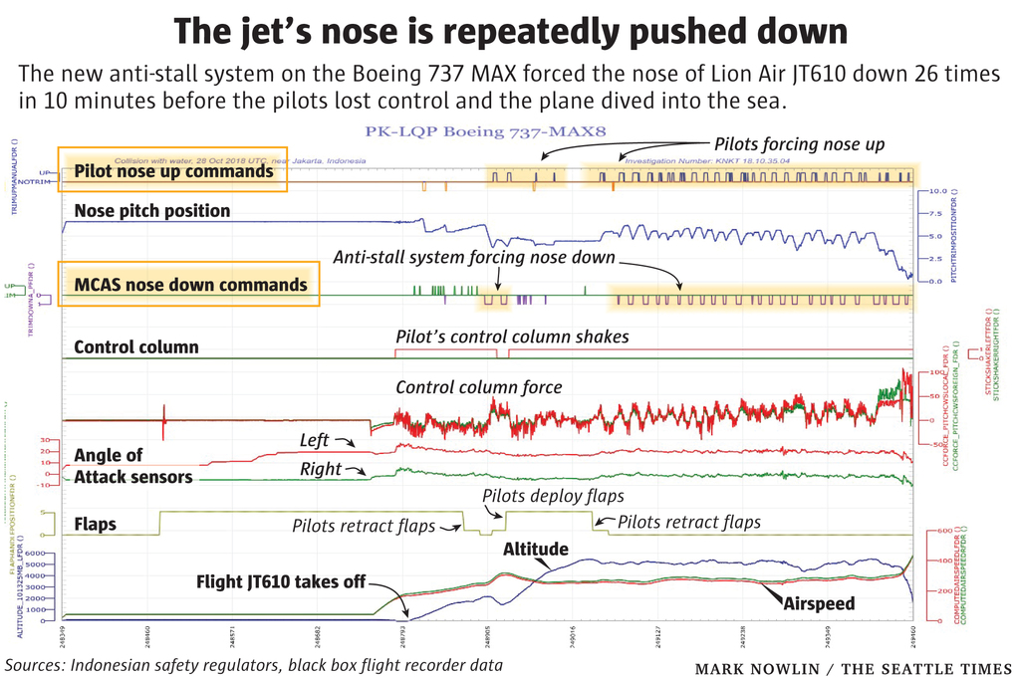

Slide 80
Fuzzy Logic
How certain are you that your data is correct?
What types of quality filters can we put on our data?
How can we error-check the data?

Slide 81
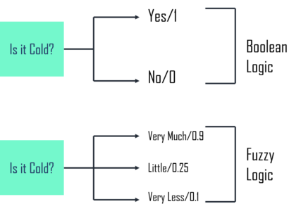
Fuzzy Logic

Slide 82
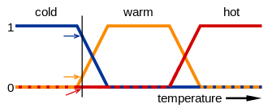
Fuzzy Logic

Slide 83
7. Data Integration

Slide 84
Visit from CapTech
Data science in the real world
Hypothesis development and testing
Value of a model
Use of qualitative and quantitative data

Slide 85
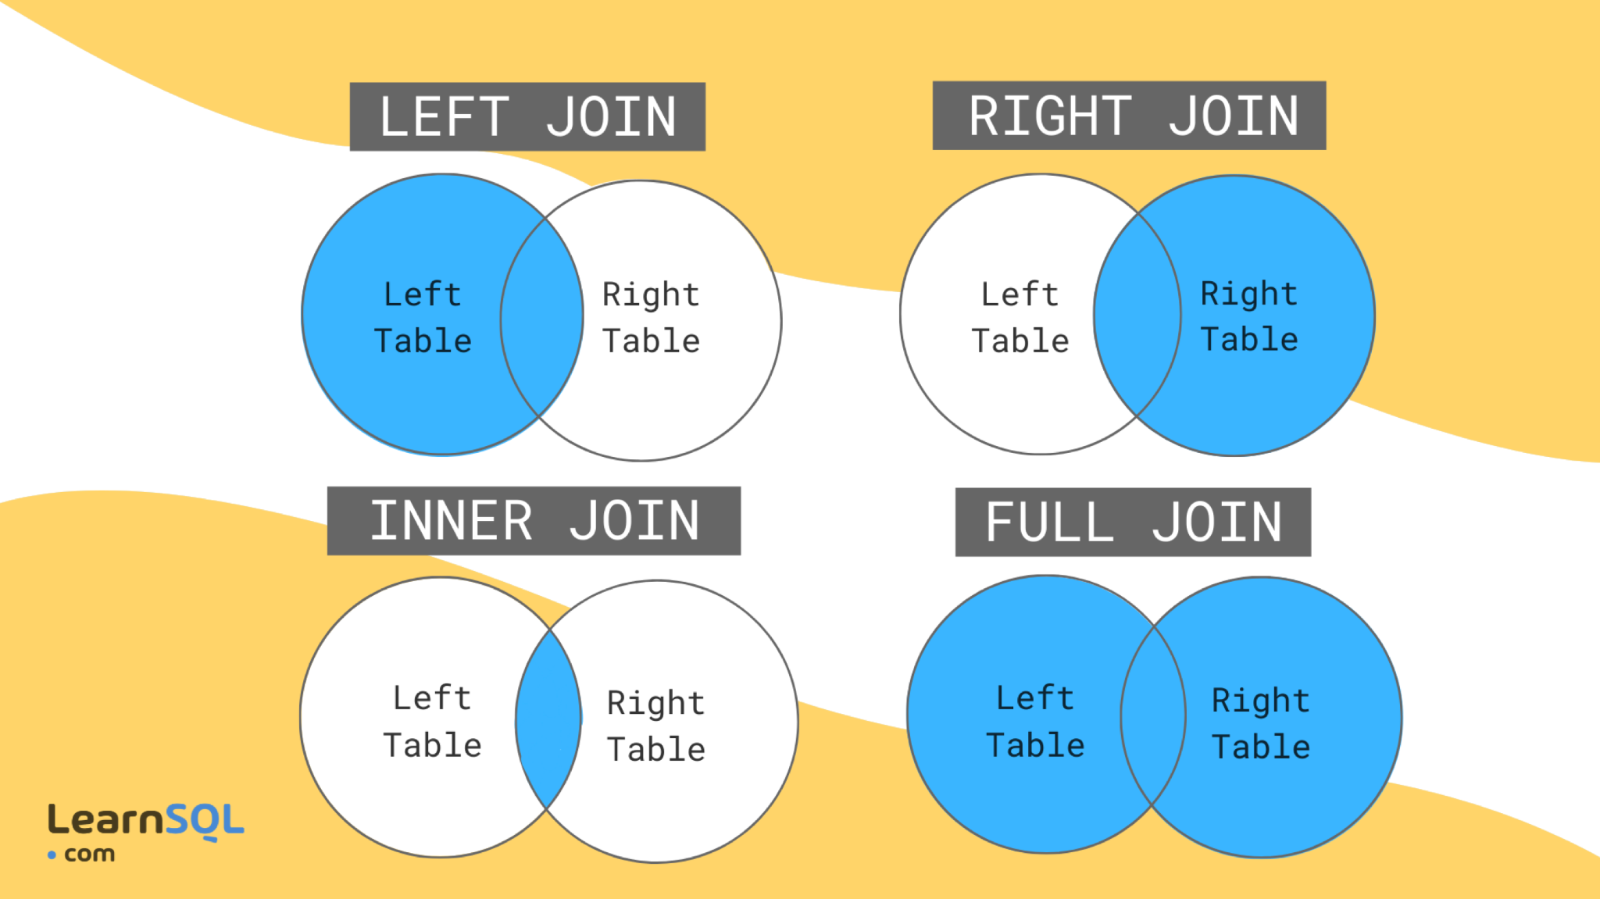

Slide 86
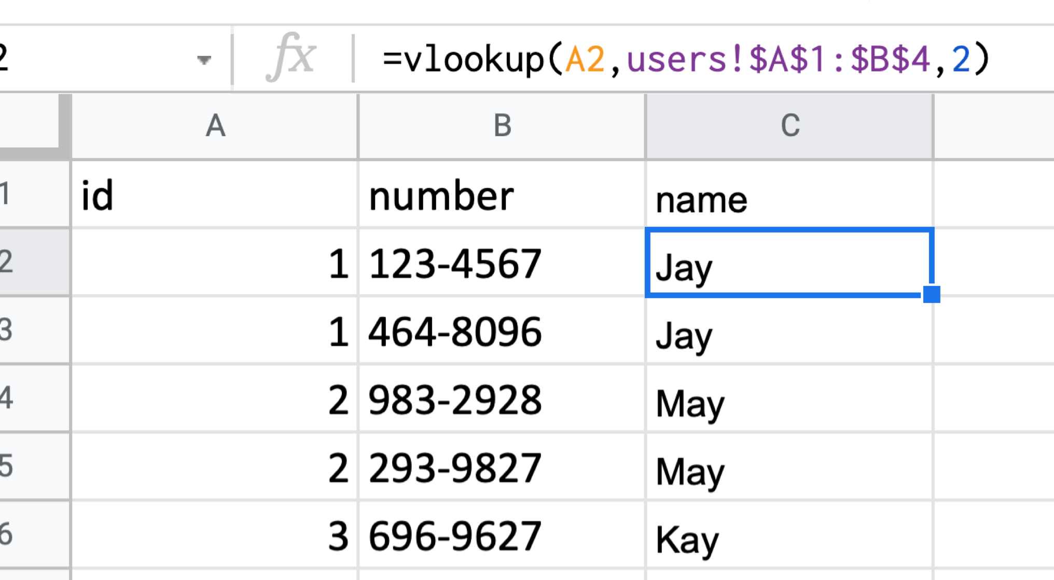

Slide 87
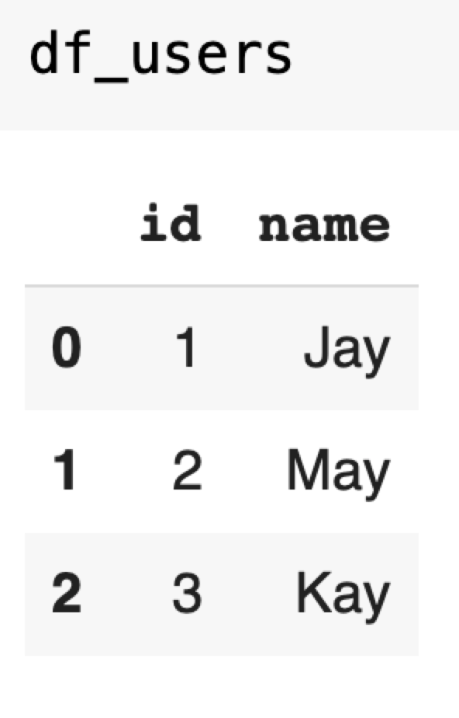
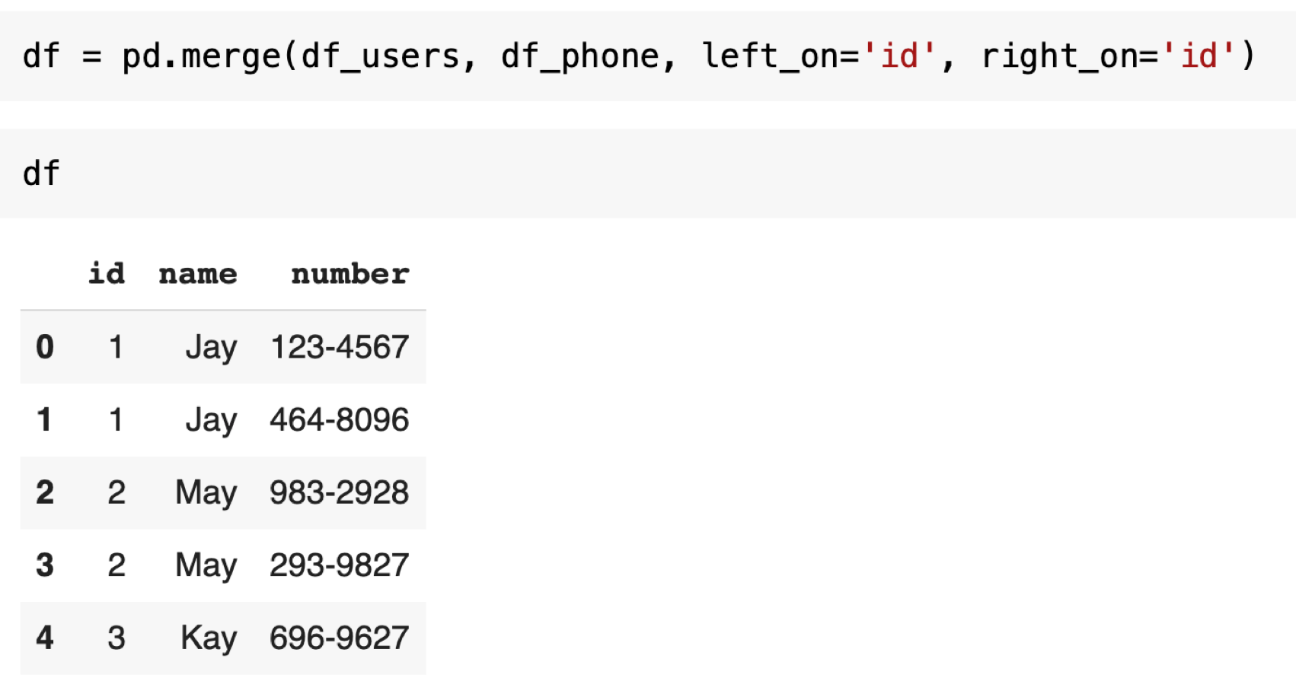
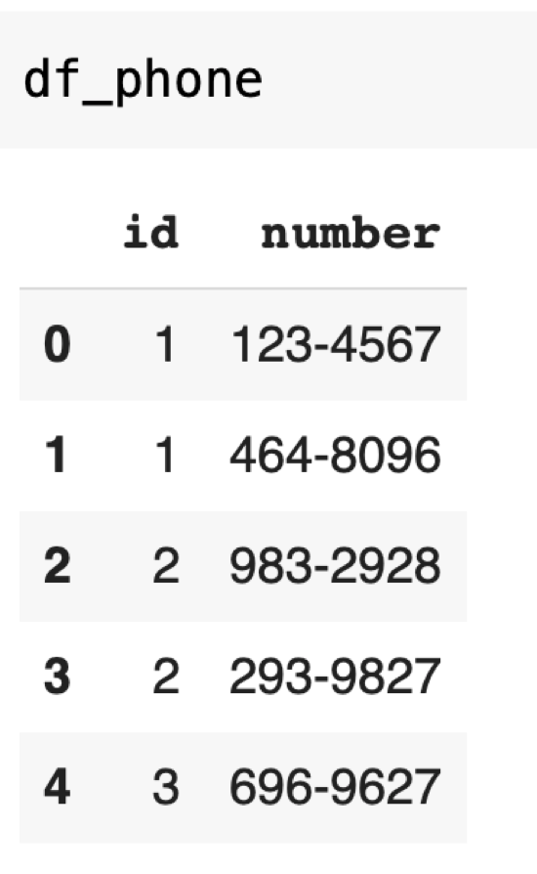

Slide 88
Before you join data...
Clean up each dataset first
Make sure the mappings between two tables make sense
Determine how to handle data that may be missing in one table

Slide 89
Take a look at the columns
Does the data have the right format?
Does the data have the right range?
Consider a transformation of the variable while preserving the original variable

Slide 90
Take a look at the rows
Are there any duplicates?
If yes, should you collapse them? If yes, how?
Should any of the rows be dropped?
Consider building some logic to examine each row and score each row to determine whether or not you should keep it

Slide 91
Prompt: Go to https://mystery.knightlab.com/ and see if you can navigate this database.

Slide 92
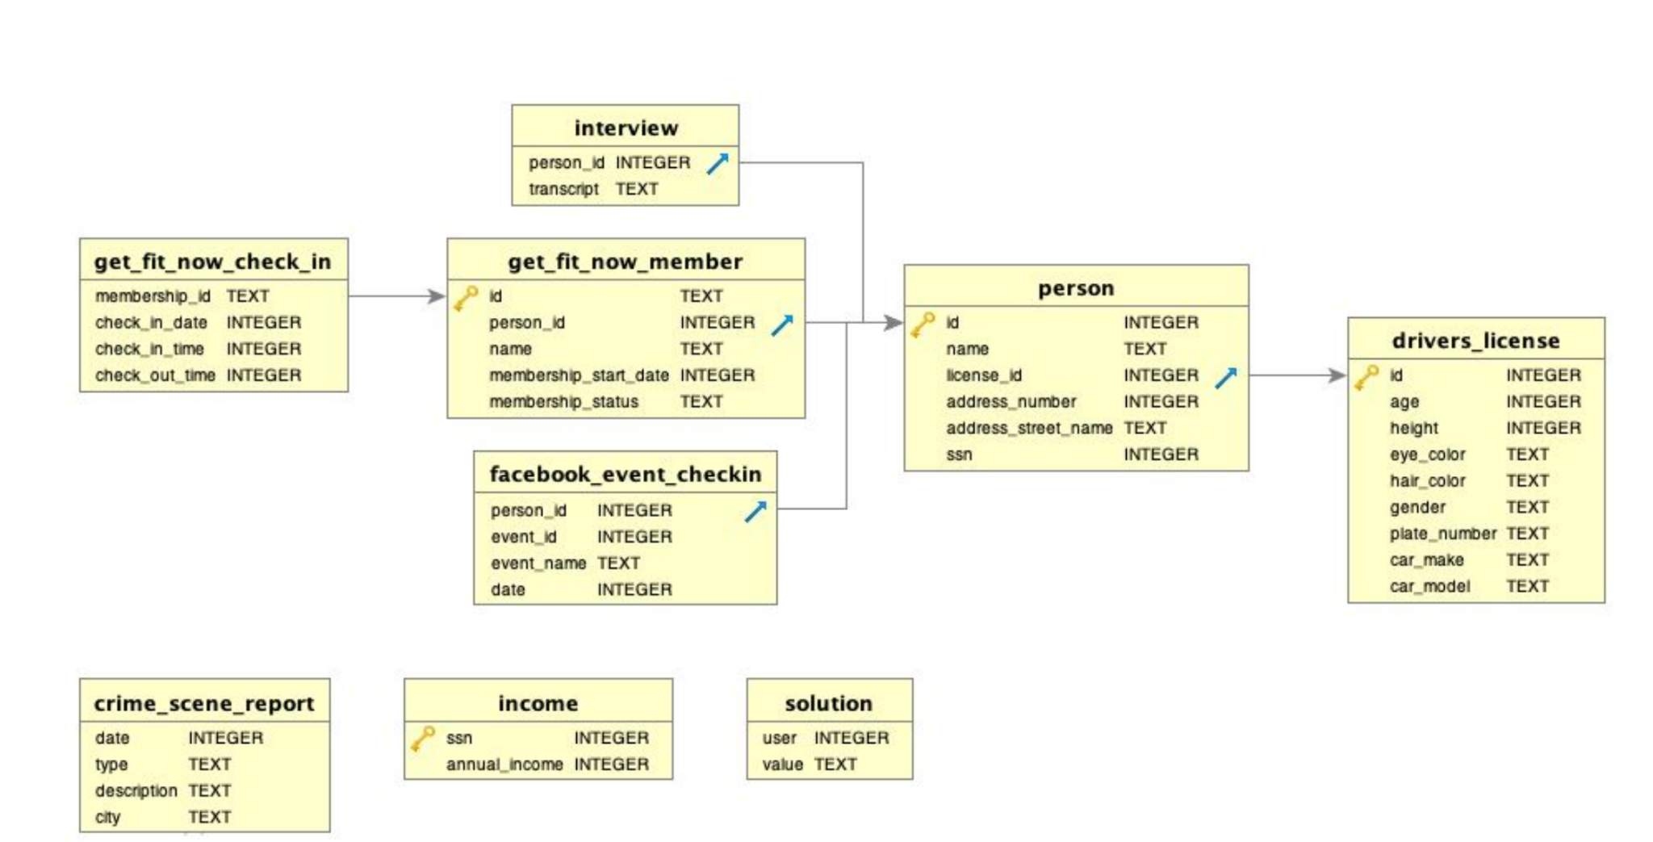
SQL

Slide 93
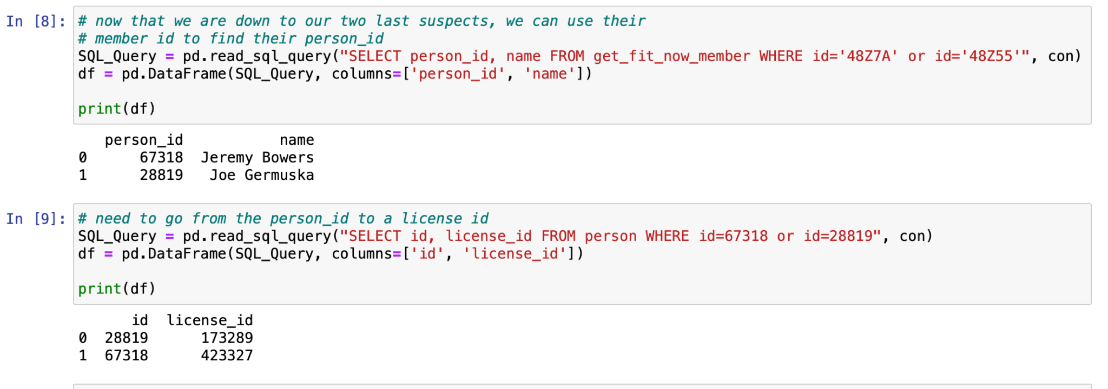
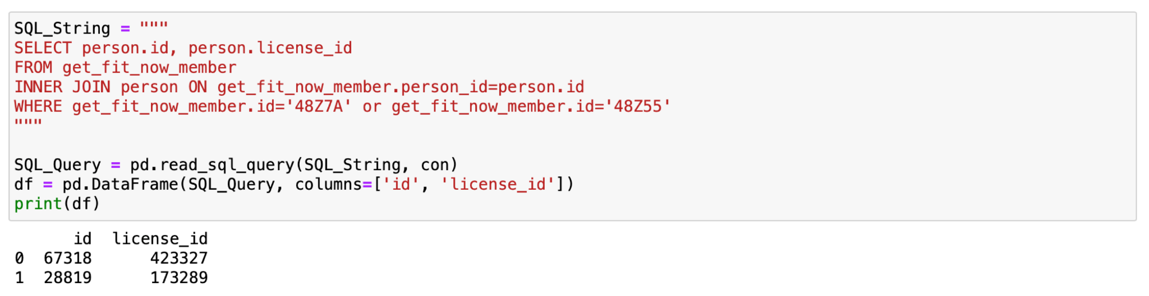

Slide 94
8. Correlations and Clustering

Slide 95


Slide 96
Prompt
If your client hands you a bunch of data and asks you to help you make sense of it, should you find a dependent variable? Yes? No? Maybe? Both?

Slide 97
Is there a dependent variable?
Yes
Some objective function or definition of success has been defined
Based on the framing, a dependent variable can be inferred
For time series data, you can identify cause-and-effect relationships
No
No one has yet defined a clear objective or definition of success
The data is complex and the cause-and-effect relationships are not evident from the outset
For time series data it is difficult to identify what comes first

Slide 98
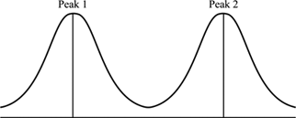
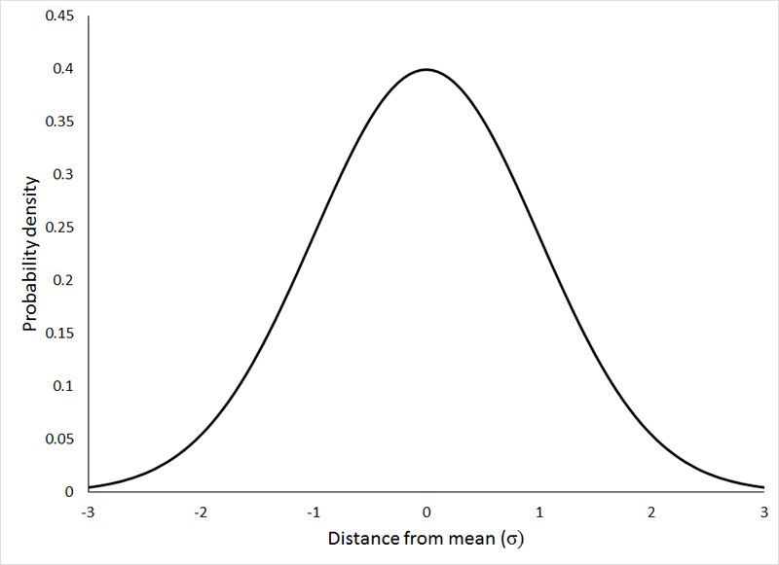
Which distribution would you prefer if you were looking at customer satisfaction?
Normal distribution
Bimodal distribution

Slide 99

Multivariate Study: Scatterplot
Based on this scatter plot, can we assume that there is a correlation between a person’s salary and their age?
Do you think outliers exist?

Slide 100
Multivariate Study: Categorical variables
Pivot Tables (cross-tabs)
Row Labels | C | PF | PG | SF | SG | Grand Total
Atlanta Hawks | 3 | 4 | 2 | 2 | 4 | 15
Boston Celtics | 3 | 3 | 4 | 1 | 4 | 15
Brooklyn Nets | 2 | 4 | 3 |  | 6 | 15
Charlotte Hornets | 3 | 3 | 3 | 1 | 5 | 15
Chicago Bulls | 2 | 5 | 2 | 2 | 4 | 15
Cleveland Cavaliers | 3 | 2 | 3 | 2 | 5 | 15

Slide 101

Cross-tabs using Pandas
The vacation data is details about vacations people have taken to different cities in different seasons.
What might this crosstab tell you about what seasons people tend to visit some cities?
pd.crosstab(df[‘col1’], df[‘col2’]....)

Slide 102

Boxplots: Compare categorical distributions
( using a categorical and a numerical variable)
Which positions have to most similar distributions?
What questions might you ask based on your observations in this graph?
Notes:
Outliers
1.5* Interquartile range (top of line) - moderate outlier; 3*IQR is extreme outlier
3rd quartile – top of box (75th percentile; 25% of observations above this value)
Line inside box = median (50th percentile; 50% of observations above this value)
Point inside box = mean
1st quartile = bottom of box (25th percentile; 25% of observations below this value)

Slide 103

Correlation vs. Causation
The number of Nobel Prizes won by a country (adjusted for population) correlates well with the per capita chocolate consumption (New England Journal of Medicine)
Notes:
Also, spurious correlations website

Slide 104

Correlations
Notes:
REcall scatterplots and correlation matrix - why it is good to look at both
Correlation coefficient:
A measure of the correlation (linear relationship) between the two variables
Quantifies the association strength
1: Perfect positive linear relationship
0 : No linear relationship
-1: Perfect negative linear relationship

Slide 105

Correlation Matrix
This is the correlation between a player’s salary and their age.
What are some conclusions we can draw based on this correlation matrix?
Can we say that a player’s salary is dependent on their age?

Slide 106
Full correlation matrix
corrmat = df.corr()
print(corrmat)
Number Age Weight Salary
Number 1.000000 0.028724 0.206921 -0.112386
Age 0.028724 1.000000 0.087183 0.213459
Weight 0.206921 0.087183 1.000000 0.138321
Salary -0.112386 0.213459 0.138321 1.000000

Slide 107


Slide 108
Heatmaps
Heatmaps are possible with the Matplotlib or Seaborn libraries, but can be tricky to set up … Here are some links to explore...
https://towardsdatascience.com/heatmap-basics-with-pythons-seaborn-fb92ea280a6c
https://blog.quantinsti.com/creating-heatmap-using-python-seaborn/

Slide 109

Heatmaps
import seaborn as sns
corrmat = df.corr()
f, ax = plt.subplots(figsize=(12, 9))
sns.heatmap(corrmat, vmax=.8, square=True);

Slide 110


Other Visualizations
Python has tons of visualization libraries and tools...check out Matplotlib and Seaborn for some good ones!

Slide 111


Slide 112
Clustering ⇔ Design Thinking
The customer may not speak with one voice so how can we aggregate customers into representative groups (e.g. clusters)?
Customer variation helps us drive the number of clusters and the differences between customer segments?
A centroid is defined as the center point of the cluster and is a great way to develop a user persona.
We can return to empathy interviews after we understand the centroids.

Slide 113




Slide 114


Slide 115

Mall customer data
(SSE = sum of squares error)
Elbow point when the SSE starts to level off

Slide 116


Slide 117


Slide 118
Clustering limitations
The definition of the clusters is determined by patterns in the data, not a well-framed problem
Biases that exist in the data may lead to problematic clusters (e.g. codifying biases in the data)
Sometimes the elbow in the graph is hard to determine

Slide 119
9. Linear Regression

Slide 120
Warm Up
If a college is trying to predict the GPA of a high school applicant, how can they factor in both SAT score and GPA along with other criteria? How can they separate the effect of each of these independent variables?

Slide 121
Is there a dependent variable?
Yes
Some objective function or definition of success has been defined
Based on the framing, a dependent variable can be inferred
For time series data, you can identify cause-and-effect relationships
No
No one has yet defined a clear objective or definition of success
The data is complex and the cause-and-effect relationships are not evident from the outset
For time series data it is difficult to identify what comes first

Slide 122


Beyond Bivariate to Multivariate
Bivariate analysis is independent of all other sources of variation
Bivariate correlation
1: perfectly positive linear
0: no relationship
-1: perfectly negative linear
Multivariate includes all independent variables
Each coefficient isolates out the effect of that independent variable
Partial derivative of the function

Slide 123
(Bi-variate) Linear Regression Assumptions
The relationship between the variables is linear
Errors (or residuals) are independent, normally distributed with mean zero and constant variance
Variable being predicted is continuous

Slide 124




Linear, Strong
Linear, Weak
Residuals
Residuals

Slide 125

Linearity
Plot each independent variable against the dependent variable

Slide 126
Regression Analysis
Linear regression analysis means “fitting a straight line to data”
Widely used technique to help model and understand real-world phenomena
Allows prediction of one dependent variable from one or more independent variables

Slide 127

Linear Regression Model
Slope
Independent Variable
Intercept
Dependent Variable
Random Error
Linear
component
Random Error
component

Slide 128


Slide 129


Slide 130
Multivariate Regression
Instead of having one x term, we can have multiple independent variables predict one dependent variable
ŷ = 𝛽₀ + 𝛽₁x₁ + 𝛽₂x₂ + … + 𝛽_{n}x_{n}+ E
The outcome variable is assumed to be a linear combination of the predictor variables (the inputs)
R² measures the proportion of variance in the observed data that is explained by the model

Slide 131
Multiple Linear Regression Assumptions
The relationship between the variables is linear
Errors (or residuals) are independent, normally distributed with mean zero and constant variance
Variable being predicted is continuous
Predictor variables are independent

Slide 132
What if Assumptions are Violated?
The relationship between the variables is linear. → Use different regression model (e.g. exponential model)
Errors (or residuals) are independent, normally distributed with mean zero and constant variance. → Non-linear data transformation (e.g. ln)
Variable being predicted is continuous. → Use logistic regression
Predictor variables are independent → Remove variables from analysis

Slide 133


Slide 134

Check for Multicollinearity
Create a correlation matrix of the independent variables in the model
For variables with high correlation, try removing the less significant variable in the model
(subset of correlation matrix)

Slide 135





Slide 136


Slide 137

Q-Q Plot
If the Q-Q Plot is not on the diagonal, the data is likely skewed in some way

Slide 138



Bad Residuals
Bad Mean
Bad Variance

Slide 139
How Well Does our Model Fit?
Coefficient of Determination, R² : Indicates how well data fit a statistical model or the proportion of total variation in outcome explained by the model
R² = 1: Regression line fits perfectly, independent variables explain all variance in outcome variable
R² = 0: Regression line does not fit at all; independent variables explain no variance in outcome variable

Slide 140
A Note about R²
WARNING: The R² statistic can be artificially inflated by adding any independent variable to the model.
R² assumes that every independent variable in the model helps to explain variation in the Dependent Variable, so it tells you the percentage of explained variation as if All IVs in the model affect the DV.
•
The adjusted R²:
- tells you the percentage of variation explained by only those IVs that truly affect the DV
AND
- penalizes you for adding independent variable(s) that do not belong in the model
•
We can compare adjusted-R² values as a heuristic to tell if adding an additional independent variable really helps.
Notes:
you can expect that the value of the adj. R2 will be ≤ value of R2

Slide 141
10. Status Presentations

Slide 142
Things to consider when presenting your status presentation:
What have you learned so far?
What are you still trying to build?
What do you think your client should do differently?
How will you test these draft recommendations?

Slide 143
Outline
Introduction Slide (client/opportunity/team)
Frame the Problem (cross-sectional vs. time-series/independent vs. dependent/
Questions (hypotheses)
Data processing (quality/joins/transformations)
Preliminary insights (graphs/charts/trends)
Model (design/results)
Next steps (improve model)
Draft recommendations
Backup slides (assumptions/correlations/additional graphs)

Slide 144
11. Classification

Slide 145


Slide 146
Predicting Event Probability
You may want to predict a discrete value (will purchase, will be accepted)
These all have a probability associated with them, but ultimately it will or won’t happen
What factors influence that?

Slide 147
Warm Up
You are helping the University of Maryland build a tool to help predict whether or not a rising senior will live on campus in the fall? How could you build such a model? How can you assess how accurate it might be?

Slide 148


Slide 149


Slide 150
Interpret Logistic Regression
Regression coefficients now represent a unit increase in the logit (log-odds)
Hard to reason about directly
Care more about significance and size relative to other predictors

Slide 151

80%
20%

Slide 152
Training and Testing
Randomly select around 80% of the observations for training a model
Build a model and then apply it to the 20% testing data (hold-out sample)
See how well your model works on your hold-out sample and look at the errors

Slide 153


Slide 154

Logistic Regression
Separating groups into two categories is something we learned using logistic regression

Slide 155


Slide 156


Slide 157


Slide 158


Slide 159


Slide 160


Slide 161
Can you predict who would survive the Titanic sinking?
Think about the sources of variation
Consider the context of the event

Slide 162


Slide 163


Slide 164


Slide 165




Slide 166

https://youtu.be/OAl6eAyP-yo

Slide 167


Slide 168


Slide 169


Slide 171


Slide 172

Decision Tree Classifier

Slide 173


Slide 174
12. Model Improvements

Slide 175
Thought question
Engineer is building a model to look at 10^6 variables that impact the deflection of a building. How can she reduce the number of variables into a more manageable set?

Slide 176
Multicollinearity

Slide 177
Principal Component Analysis (PCA)
Examine the patterns among the variables
Generate new variables that are defined by
Maximizing the uniqueness of each variable
i.e. minimizing the correlation between the components

Slide 178


4 dimensions
2 dimensions

Slide 179




Slide 180


Slide 181
Dimensions
What do we mean by looking at the number of dimensions?
These are 10 dimensional vectors:
Vector1 = [1, 0, 1, 0, 0, 0, 1, 0, 0, 0]
Vector 2 = [1, 0, 0, 0, 0, 0, 1, 1, 0, 1]
…
Vector n = [0, 0, 1, 0, 0, 0, 0, 1, 1, 1]
Can we collapse them into fewer number of dimensions based on patterns?

Slide 182
Intuition
The things that are measured may be formed into a variable that cannot be measured but more accurately represents underlying measures:
e.g. the person is fit or not fit based on the underlying measures of height, weight, body fat index, …
The things that are measured have sufficient overlap they need to be decomposed into separate variables
e.g. the person’s weight contributes both to their fitness as well as looks

Slide 183

Dimensionality Trade-Off

Slide 184


Slide 185


Slide 186


Slide 187


notebook

Slide 188


Slide 189
Thought exercise
Campbell’s currently uses people to visually inspect tomatoes before they are used as an ingredient in soup. Could this be automated? What data science considerations are there?

Slide 190


Slide 191
Turning an image into numbers
Easier than you might think when the image is digital already
Facial recognition uses this

Slide 192




notebook

Slide 193


Slide 194
14. Storytelling with Data

Slide 195
15. The Future of Data Science

Slide 196
Prompt
How could a new product development company use data science to make bespoke products for consumers?

Slide 197


Slide 198


Slide 199


Slide 200


Slide 201


Slide 202
Moving from development to production
How to decide where to locate your data
How to use distributed data for faster analytics
How to think about big data
How to think about advanced models (e.g. deep learning)
How to build better tools

Slide 203


Slide 204


Slide 205
What comes next in 390?
Interpolation vs. Extrapolation
Descriptive vs. Normative
Current vs. Future

